Slide 1
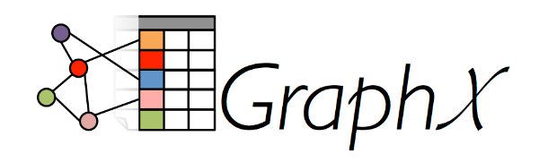
Spark GraphX
Dingtinghe
dingth@chinatelecom.cn

Slide 2
History
Pregel: a system for large-scale graph processing in Google.
Bagel is a Spark implementation of Google’s Pregel graph processing framework.
Bagel is deprecated, and superseded by GraphX.

Slide 3
Introduction
GraphX is a new component in Spark for graphs and graph-parallel computation.
At a high level, GraphX extends the Spark RDD by introducing a new Graph abstraction: a directed multigraph with properties attached to each vertex and edge.

Slide 4

Getting Started

Slide 5
The Property Graph
A directed multigraph is a directed graph with potentially multiple parallel edges sharing the same source and destination vertex.
The ability to support parallel edges simplifies modeling scenarios where there can be multiple relationships between the same vertices.
Each vertex is keyed by a unique 64-bit long identifier (VertexID). GraphX does not impose any ordering constraints on the vertex identifiers.
Similarly, edges have corresponding source and destination vertex identifiers.

Slide 6
Like RDDs, property graphs are immutable, distributed, and fault-tolerant.
Changes to the values or structure of the graph are accomplished by producing a new graph with the desired changes.
Note that substantial parts of the original graph (i.e., unaffected structure, attributes, and indicies) are reused in the new graph reducing the cost of this inherently functional data structure.
The graph is partitioned across the executors using a range of vertex partitioning heuristics.
As with RDDs, each partition of the graph can be recreated on a different machine in the event of a failure.
Logically the property graph corresponds to a pair of typed collections (RDDs) encoding the properties for each vertex and edge.

Slide 7

The classes VertexRDD[VD] and EdgeRDD[ED] extend and are optimized versions of RDD[(VertexID, VD)] and RDD[Edge[ED]] respectively.
Both VertexRDD[VD] and EdgeRDD[ED] provide additional functionality built around graph computation and leverage internal optimizations.

Slide 8
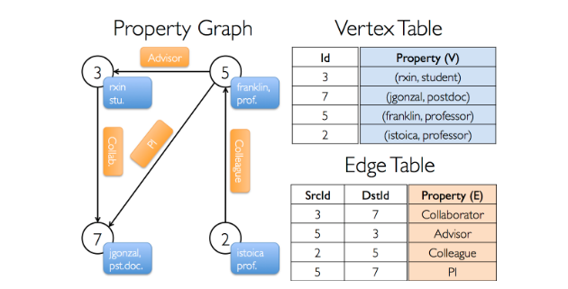
Example Property Graph

Slide 9
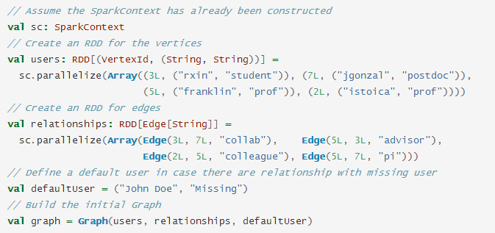
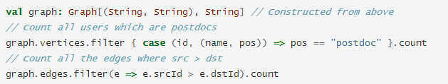

Slide 10


Triplet
The triplet view logically joins the vertex and edge properties yielding an RDD[EdgeTriplet[VD, ED]] containing instances of the EdgeTriplet class.

Slide 11
Graph Operators
Graph AND GraphOps
The core operators that have optimized implementations are defined in Graph
Convenient operators that are expressed as a compositions of the core operators are defined in GraphOps.
However, thanks to Scala implicits the operators in GraphOps are automatically available as members of Graph.

Slide 12
Summary List of Operators
Property Operators
Structural Operators
Join Operators
Neighborhood Aggregation
Aggregate Messages
Map Reduce Triplets Transition Guide (Legacy)
Computing Degree Information
Collecting Neighbors
Caching and Uncaching

Slide 13
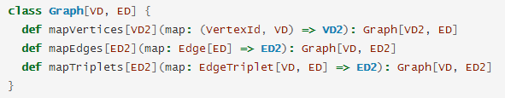
Property Operators

Slide 14
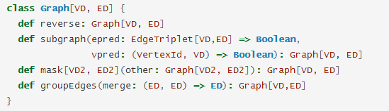
Structural Operators
The subgraph operator defaults to true if the vertex or edge predicates are not provided.

Slide 15
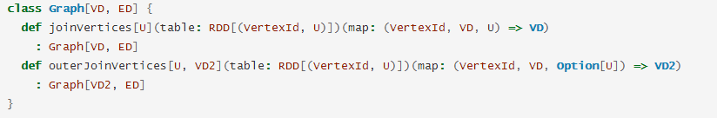
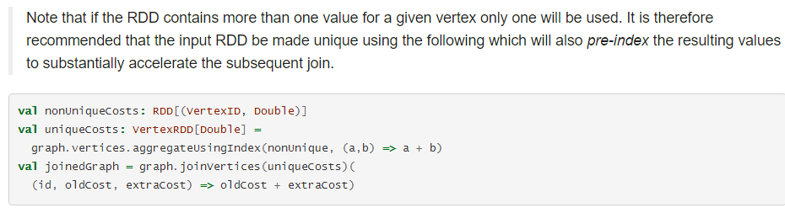
Join Operators

Slide 16
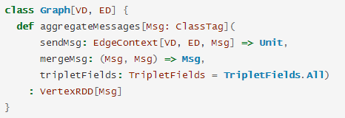
Neighborhood Aggregation
This operator applies a user defined sendMsg function to each edge triplet in the graph and then uses the mergeMsg function to aggregate those messages at their destination vertex.
Vertices that did not receive a message are not included in the returned VertexRDD.
The tripletFields argument can be used to notify GraphX that only part of the EdgeContext will be needed allowing GraphX to select an optimized join strategy

Slide 17
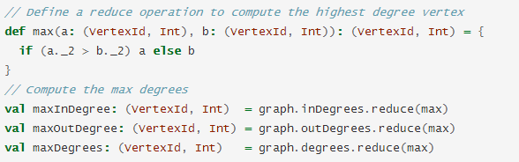
Computing Degree Information

Slide 18
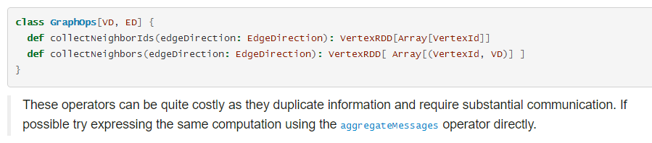
Collecting Neighbors

Slide 19
Caching and Uncaching
Because graphs are composed of multiple RDDs, it can be difficult to unpersist them correctly.
For iterative computation we recommend using the Pregel API, which correctly unpersists intermediate results.

Slide 20

Pregel API
At a high level the Pregel operator in GraphX is a bulk-synchronous parallel messaging abstraction constrained to the topology of the graph. The Pregel operator executes in a series of super steps in which vertices receive the sum of their inbound messages from the previous super step, compute a new value for the vertex property, and then send messages to neighboring vertices in the next super step.

Slide 21


Slide 22
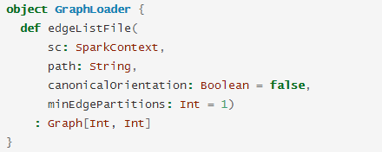
Graph Builders
Graph.groupEdges requires the graph to be repartitioned because it assumes identical edges will be colocated on the same partition, so you must call Graph.partitionBy before calling groupEdges.
The canonicalOrientation argument allows reorienting edges in the positive direction (srcId < dstId), which is required by the connected components algorithm. The minEdgePartitions argument specifies the minimum number of edge partitions to generate

Slide 23
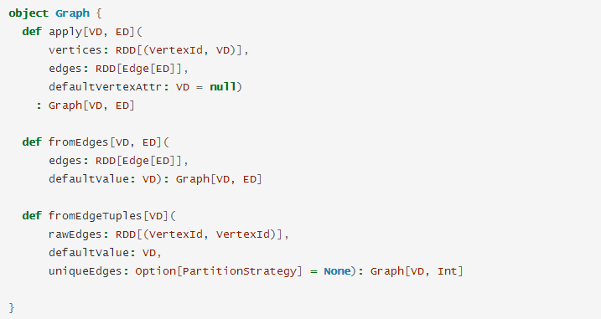

Slide 24
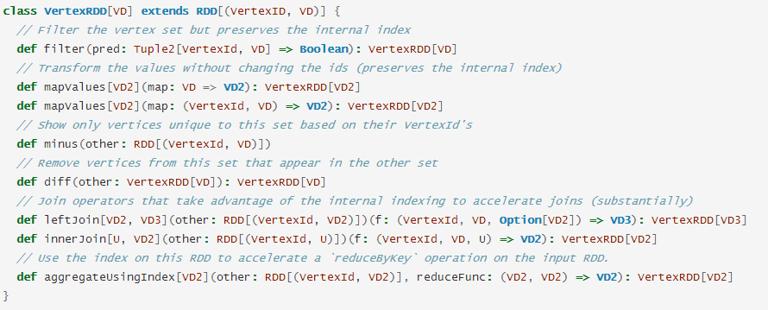
Vertex and Edge RDDs

Slide 25
Likewise, the mapValues operators do not allow the map function to change the VertexID thereby enabling the same HashMap data structures to be reused.
The aggregateUsingIndex operator is useful for efficient construction of a new VertexRDD from an RDD[(VertexID, A)].

Slide 26
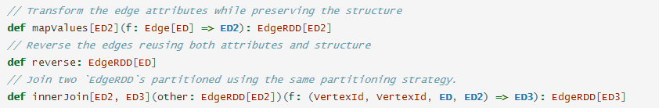
EdgeRDDs

Slide 27
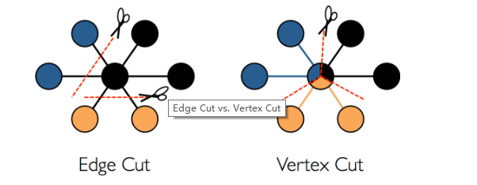
Optimized Representation
GraphX adopts a vertex-cut approach to distributed graph partitioning

Slide 28
Graph Algorithms
PageRank
Connected Components
Triangle Counting

